Slide 1
WELCOME BACK
Reopening of the General Accounting Office

Slide 2
Welcome back, your dreams were your ticket out Welcome back, to that same old place that you laughed about Well the names have all changed since you hung around But those dreams have remained and they've turned around Who'd have thought they'd lead ya (Who'd have thought they'd lead ya) Back here where we need ya (Back here where we need ya) Yeah we tease him a lot 'cause we got him on the spot Welcome back, welcome back, welcome back, welcome back Welcome back, welcome back, welcome back
We always could spot a friend, welcome back And I smile when I think how you must have been And I know what a scene you were learning in Was there something that made you come back again And what could ever lead ya (What could ever lead ya) Back here where we need ya (Back here where we need ya) Yeah we tease him a lot 'cause we got him on the spot Welcome back, welcome back, welcome back, welcome back Welcome back, welcome back
Songwriter: John Benson Sebastian

Slide 3
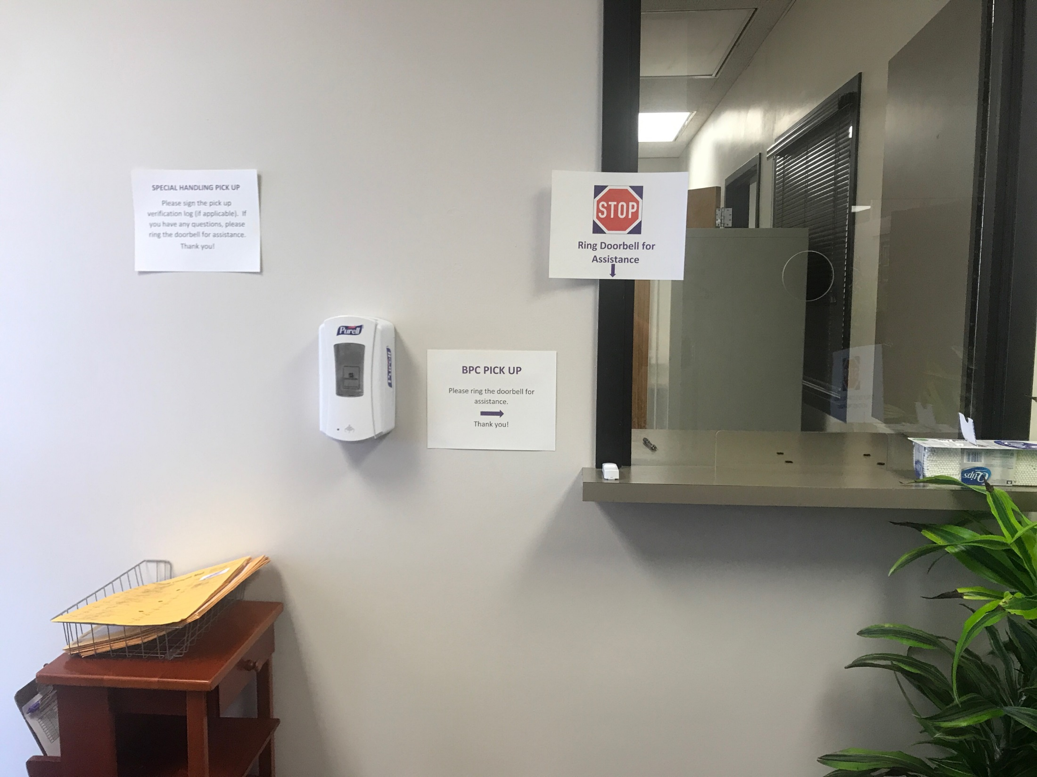

Slide 4
2323 ANDERSON AVENUE, SUITE 500
Welcome & Come in! We are Happy to see you again!
Our inside lobby area is now open and we have new hours of operation! Our doors will be open from 10 a.m. – 12 p.m. and 1 – 3 p.m. Monday through Friday.
Only DFS General Accounting and Purchasing employees will be allowed past the reception area. Signage is posted asking visitors not to go past reception
A Drop Off box will remain outside the doors for contactless delivery
On a table to your left as you enter through the door is the Special Handling Pick Up
For any in person assistance needed please ring the door bell
For BPC pick up ring the door bell and don’t forget……….

Slide 5
Some Basic Card Facts
Only the cardholder may pick up the BPC if they are a first time cardholder obtaining their first card and must sign the cardholder agreement.
Others may pick up a BPC with e-mail consent provided it is a renewal, reissuance, or replacement, and not a first time card
It is important to submit the BPC voucher accounting for the credit card charges on a timely basis as DFS pays the bill up front on behalf of the entire campus and all cardholders. Only through the submission and processing of the vouchers is our account replenished to pay the next months statement.
Monthly submission deadline is the 15th of the month. If the 15th falls on a weekend then the next business day becomes the due date.

Slide 6
That was your Tuesday tidbit!
Thank you and enjoy the rest of your week!

